Slide 1

Vanguard Digital A/B Testing Mobile UI
M. Riabchynskyi | H. Stuck | P. Sikder | J. Vidal
Notes:
SLIDE 1 — INTRO
Good morning everyone, and thank you for being here.
We are Northbridge Digital Consulting, and for this project, Vanguard asked us
to evaluate whether their redesigned digital interface should be rolled out to
users.
The objective of this analysis was not only to determine whether the new
interface improves completion rates, but also whether it provides a genuinely
better user experience.
Throughout this presentation, we will show that although the new interface
improves completion performance, the user journey itself becomes significantly
more friction-heavy, especially for older and more valuable clients.
Husseim
Who we are
what our company is
team members
Who we are:
Digital strategy & UX analytics consulting
Specialized in data-driven product decisions
What we do:
A/B testing analysis
Customer behavior insights
Product optimization

Slide 2
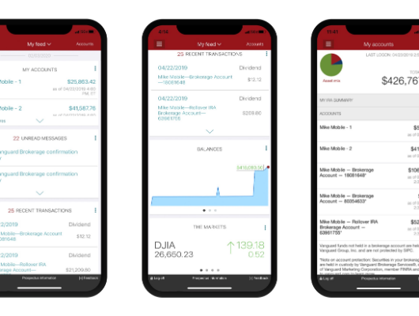


Vanguard Digital Challenge Analysis
Business Context
Vanguard:
• Global investment management company
• Digital mobile platform for managing investments
Objective/Hypothesis:
Does the new modern interface perform better than the old one?
Performance: Completion Rate
Navigation: User Experience
Notes:
SLIDE 2 — BUSINESS CONTEXT
Vanguard is one of the world’s largest investment management companies,
offering digital tools that allow clients to manage investments and financial
portfolios online.
Vanguard recently introduced a redesigned interface and conducted an A/B test
comparing the old and new versions.
The key business question was simple:
“Does the redesigned interface actually perform better than the current one?”
To answer that question, we focused on two dimensions:
First, performance — meaning whether users complete the process.
And second, user experience — meaning how users navigate through the
process.
Husseim
3. BUSINESS PROBLEM
Aquí defines TODO el proyecto.
Slide:
Vanguard launched a redesigned digital interface
Objective:
Improve completion of digital processes
Key question:
Should Vanguard roll out the new experience?
Define también friction (clave):
Friction = non-linear navigation:
Backtracking
Repeated steps
Step jumps
A/B Test Design
Control → Traditional interface
Test → Redesigned interface
Unit of Analysis
• Sessions that started the process
Main KPIs
• Completion Rate
• Friction Rate
• Backtracking & Repeated Steps
• Time & Efficiency
:speech_balloon: Aquí metes ya el framing importante:
“Higher completion is good — but not if it comes with worse user experience.”

Slide 3


Experiment Setup
A/B Test:
Group_1: Control → Current interface
Group_2: Test → Redesigned interface
Analysis Scope:
Users that started the process
Core Metrics:
Completion
Friction (backtracking, repeated steps)
Key concepts:
KPI´S:
Friction: Non - linear app navigation
Backtracking: People who went back in the steps
Repeated steps: Repeating the same step more than once
Completion Rate:
percentage of started sessions reaching confirm
Friction Rate:
percentage of started sessions not following a clean journey
Efficiency:
Median completion time
Notes:
SLIDE 3 — EXPERIMENT SETUP
The experiment compared two groups.
The Control group used the current interface, while the Test group used the
redesigned version.
Our analysis only focused on users who actually started the process, because
sessions that never entered the flow cannot meaningfully evaluate the interface
itself.
We analyzed several KPIs related to completion, friction, and efficiency.
In particular, we focused on behaviors such as backtracking — meaning users
moving backwards through steps — and repeated steps, where users revisit the
same step multiple times.
These metrics allow us to understand not only whether users finish, but also
how smooth or complex the journey feels.
Husseim
A/B Test Design
Control → Traditional interface
Test → Redesigned interface
Unit of Analysis
• Sessions that started the process
Main KPIs
• Completion Rate
• Friction Rate
• Backtracking & Repeated Steps
• Time & Efficiency

Slide 4
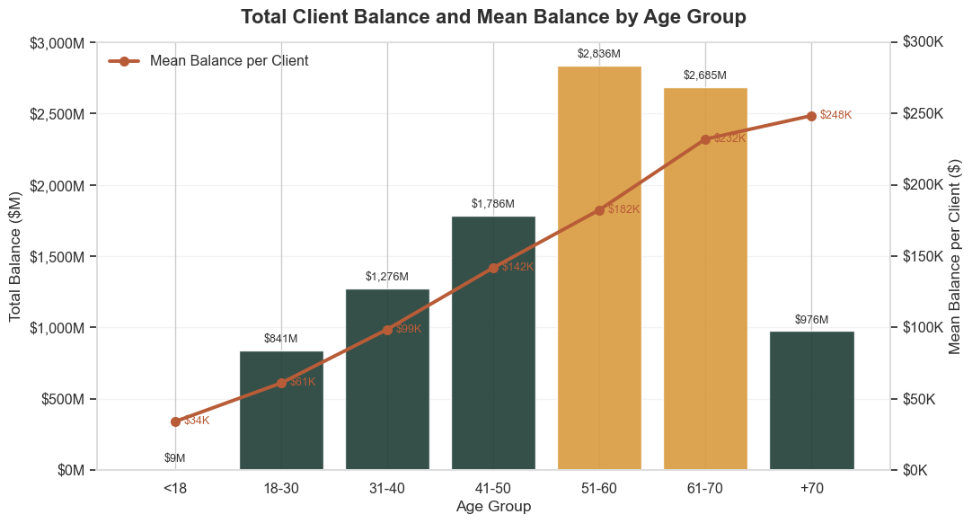
Vanguard´s most desired Customer Profile
Client base concentrated in adult segments
Largest segment: 50–59 (≈22%)
Younger users represent a small share
Gender are represented equally
Client value increases with age, with 51–70 representing the largest share of total balance
Notes:
yellow segments are the ones to protect.
Key Insight: Client value increases with age,
with 51–70 representing the largest share of total balance

Slide 5
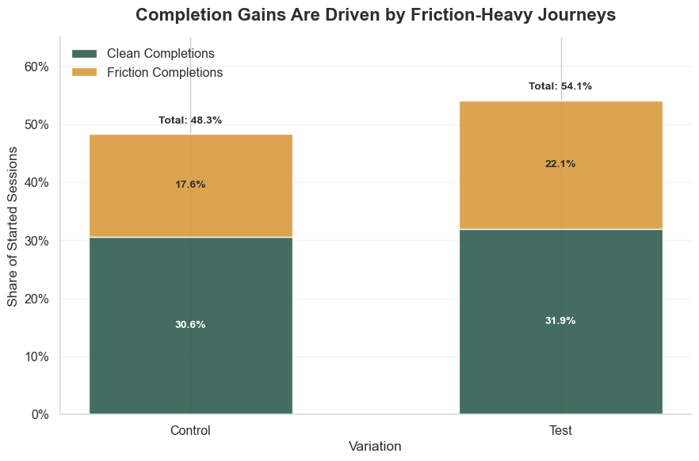
First results
Where does the improvement come from?
Completion increases in Test
Most of the uplift comes from friction-heavy journeys
Median Completion Time:
Control: 4.52 min
Test: 3.95 min
Faster ≠ simpler
About ~68–69% of sessions involve friction
Notes:
Completion Rate:
Control: 48.26%
Test: 54.07%
+5.81 percentage points
Completion Rate difference is statistically significant (p < 0.0001)
// Optional text for slide: -> First Results
Where does the improvement come from?
• Completion increases in Test
• Most of the uplift comes from friction-heavy journeys
Efficiency
• Faster completion time
• Same number of steps
Key Insight
Faster ≠ simpler

Slide 6
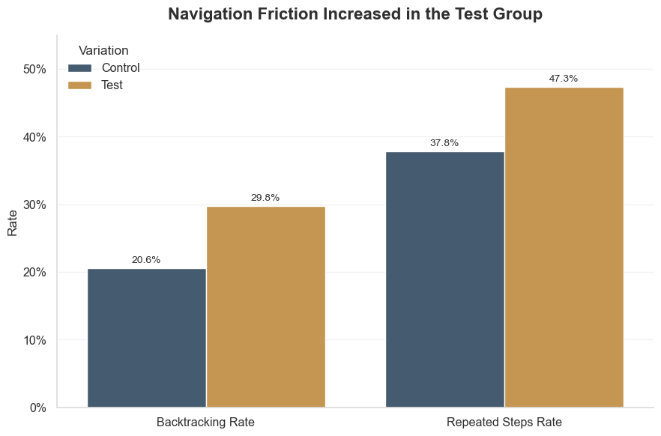
Navigation friction
What type of friction increased?
Backtracking increased by +9.20 pp
Repeated steps increased by +9.55 pp
The new interface increased non-linear navigation

Slide 7
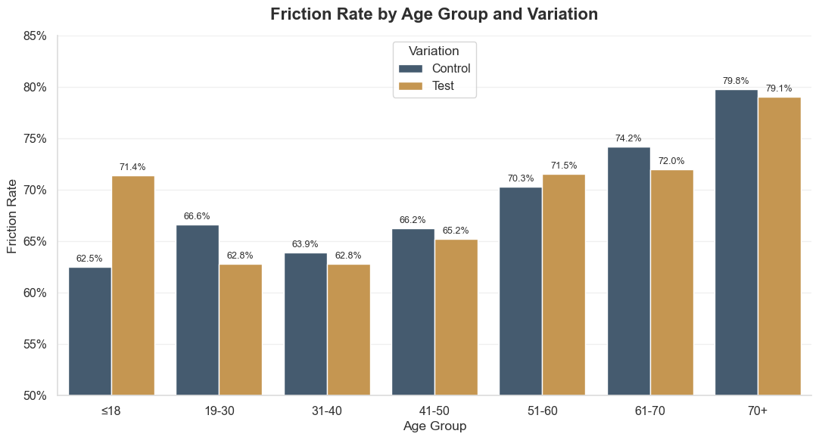
Friction impact by age
Friction Impact by Age
Friction increases with age
Older users are more affected
High-value clients are more exposed to friction

Slide 8

Business Risk
Friction tends to increase with user age
High-value clients experience a disproportionate impact
Navigation complexity is higher in the test group
The new version may negatively impact Vanguard’s most valuable customers, posing a significant risk to retention and satisfaction

Slide 9
Recommendations
Key takeaway
Do not proceed with the rollout of the current interface in its present form
Next Steps:
Conduct a detailed analysis of friction points across user journeys
Identify and prioritize the most problematic interaction steps
Redesign and streamline navigation before any broader deployment
Higher completion ≠ better experience
Completion rates have improved, but significant friction remains in the user experience and is not at an acceptable level
Reducing user friction is a prerequisite for launch readiness
Notes:
Improving performance means nothing if user trust is lost along the journey.

Slide 10

THANK YOU FOR YOUR ATTENTION!
Are there any questions?
Team: M. Riabchynskyi | H. Stuck | P. Sikder | J. Vidal
Github Repo:
Repo Link
Tableau Dashboard:
KPI: Link
Client KPI: Link
Completion/Friction: Link
Kanban: Link

